Slide 1

Recent Advancements in Natural Language Processing
Naeemullah Khan
naeemullah.khan@kaust.edu.sa
KAUST Academy
King Abdullah University of Science and Technology
July 18, 2025
Recent Advancements in NLP
1

Slide 2
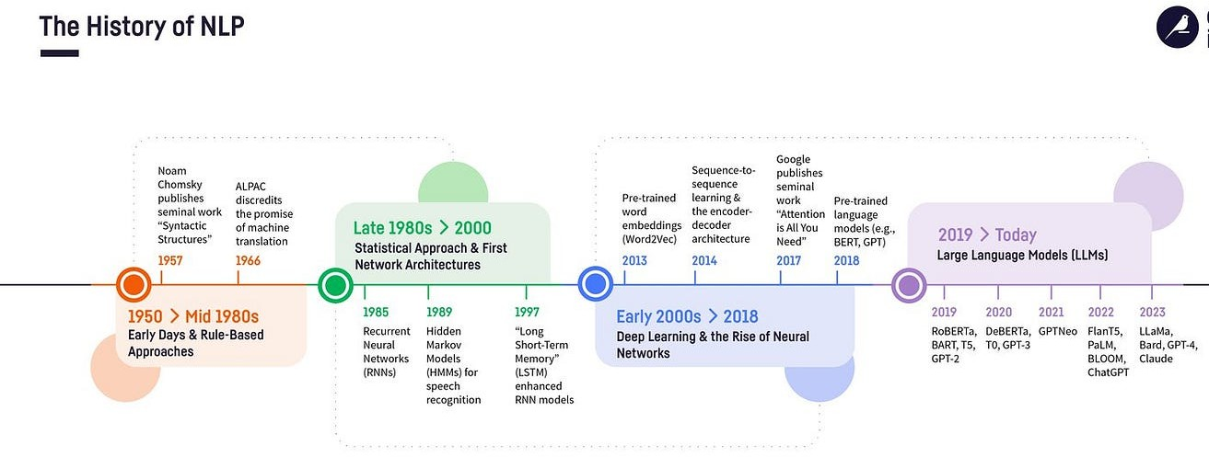
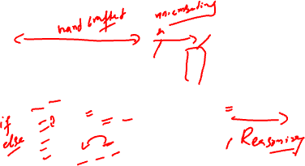

Slide 3
Table of Contents
Motivation
Learning Outcomes
Mixture of Experts (MoE)
FlashAttention-2
The LLaMA 3 Herd of Models
DeepSeek & GRPO
Byte Latent Transformer (BLT)
Large Language Diffusion Models (LLDMs)
Segment Everything Everywhere All at Once (SEEM)
Summary
References
Recent Advancements in NLP

Slide 4
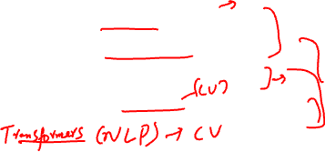
Motivation
The field of Artificial Intelligence (AI) is evolving rapidly, with significant breakthroughs across various domains:
▶ Vision, Language, and Multimodal learning
▶ Faster inference: FlashAttention-2 enables more efficient model computations.
▶ Scalable learning: Mixture of Experts (MoE) allows models to scale effectively.
▶ Open-weight LLMs: Releases like LLaMA 3 and DeepSeek foster transparency and accessibility.
▶ Emerging paradigms: Diffusion models in language and BLT (Bidirectional Language Transformers) are shaping new research directions.
Recent Advancements in NLP

Slide 5
Motivation (cont.)
Staying updated with these advances is essential for modern AI development and research.
Recent Advancements in NLP

Slide 6
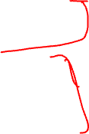
Learning Outcomes
By the end of this session, you should be able to:
▶ Recognize efficiency improvements in transformers, such as FlashAttention-2.
▶ Compare Mixture-of-Experts (MoE) architectures with dense transformer models.
▶ Explore state-of-the-art open-source LLMs, including LLaMA 3 and DeepSeek.
▶ Learn about emerging modeling paradigms, such as Blockwise Layer Training (BLT) and Large Language Diffusion Models (LLDMs).
▶ Understand recent innovations in segmentation, attention mechanisms, and large language models (LLMs).
Recent Advancements in NLP

Slide 7
FlashAttention
Recent Advancements in NLP

Slide 8
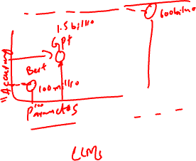
Scale Brings Quality and Capabilities

Slide 9
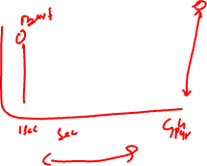
Core Challenge with Scale: Efficiency

Slide 10
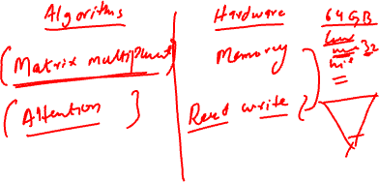
Understanding Algorithms & Systems

Slide 11
Background
TILING FOR MATRIX MULTIPLICATION

Slide 12
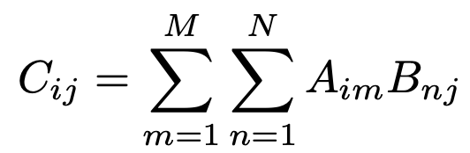
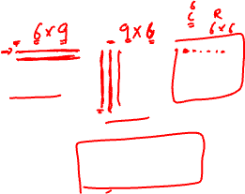
Tiling for Matrix Multiplication
A
B C
x
=
Matrix multiplication computes each output value as a dot-product of a row/column pair from the input matrices

Slide 13
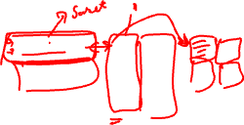
Tiling for Matrix Multiplication
A
B C
x
=
We can view the computation as decomposing if we consider subsets of rows/columns
^{C}(1 1):(3 3) ^{= A}(1 1):(3 9) ^{× B}(1 1):(9 3)
, , , , , ,

Slide 14
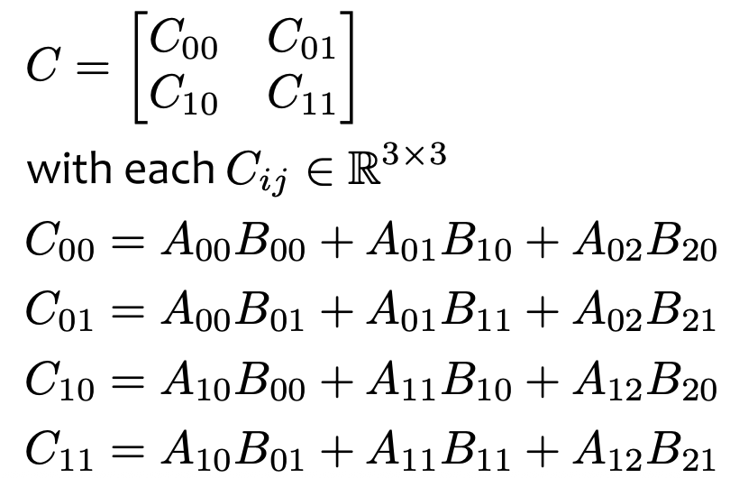
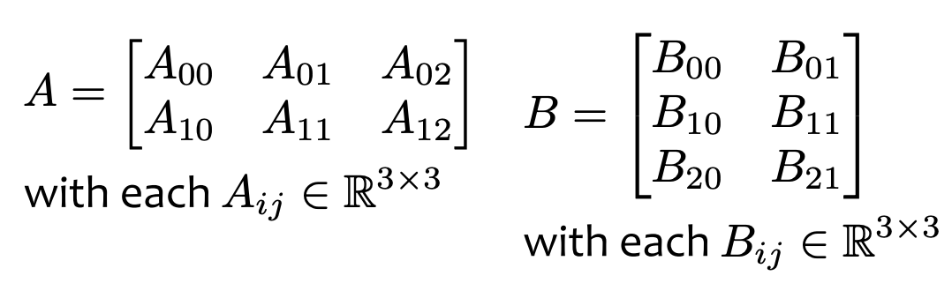
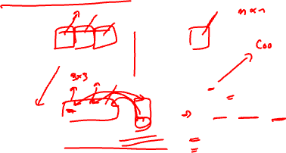
Tiling for Matrix Multiplication
Tiling capitalizes on this decomposition
Each output tile is computed by multiplying a pair of input tiles and adding it to the appropriate output tile
A
B C
x
=

Slide 15
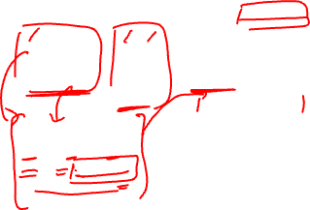
Tiling for Matrix Multiplication
large/slow memory
Tiling enables matrix multiplication of two very large matrices to capitalize on the small amount of fast memory on a device (e.g. GPU)
Start by putting
the input matrices and storage for the output matrix into large/slow memory
Do the primary computation in
slow/fast memory
A
B C
x
=
C00 = A00B00 + A01B10 + A02B20
X = A₀₀
Y = B₀₀
Z = XY X = A
X
Y
Z
X = A
01
02
small/fast memory
Y = B₁₀
Z = Z + XY
Y = B₂₀
Z = Z + XY C₀₀ = Z
12

Slide 16
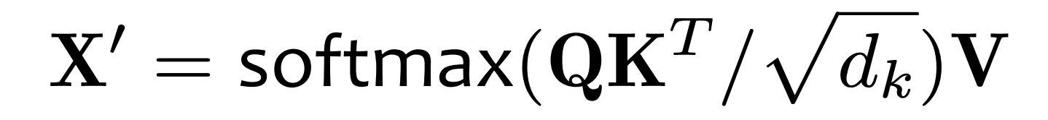
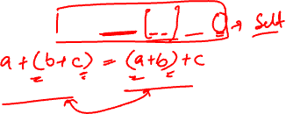
Tiling for Self-Attention?
It would be great if we could directly use tiling for self- attention
Unfortunately, whereas the addition in matrix multiplication is associative, the softmax in self-attention is not!

Slide 17
Background
ONLINE SOFTMAX

Slide 18
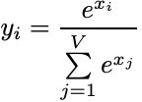
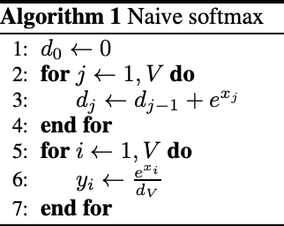
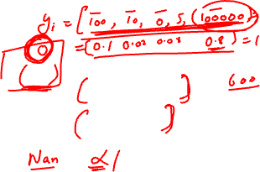
Regular Softmax
The standard softmax computation is used heavily throughout deep learning
Yet, often we need to compute
softmax on very large logits
To avoid issues of overflow when raising e to some
large power, we can use the safe softmax instead
Every deep
learning library implements this
Figure from https://arxiv.org/pdf/1805.02867

Slide 19
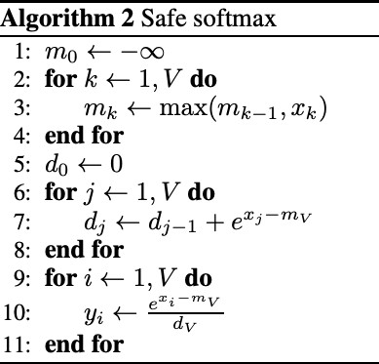
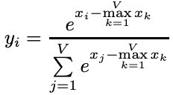
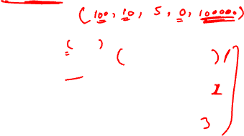
Safe Softmax
The standard softmax computation is used heavily throughout deep learning
Yet, often we need to compute
softmax on very large logits
To avoid issues of overflow when raising e to some
large power, we can use the safe softmax instead
Every deep
learning library implements this
Figure from https://arxiv.org/pdf/1805.02867

Slide 20
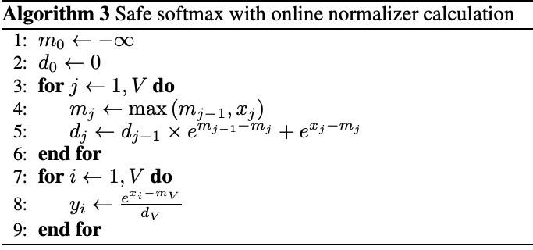
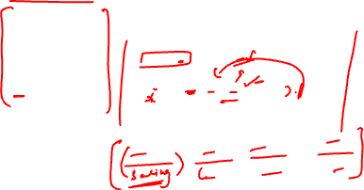
Online Softmax
The problem with the usual safe softmax is that it requires three iterations, with each one accessing memory
Online softmax reduces this
to only two iterations through the data!
This results in not only a 1.33x
apparent speedup, but also a
1.3x speedup in practice
because of reduced memory bandwidth requirements
Figure from https://arxiv.org/pdf/1805.02867

Slide 21
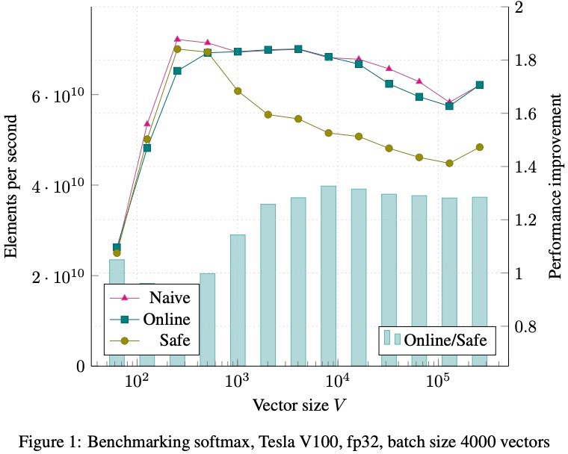
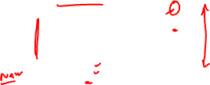
Online Softmax
The problem with the usual safe softmax is that it requires three iterations, with each one accessing memory
Online softmax reduces this
to only two iterations through the data!
This results in not only a 1.33x
apparent speedup, but also a
1.3x speedup in practice
because of reduced memory bandwidth requirements
Figure from https://arxiv.org/pdf/1805.02867

Slide 22
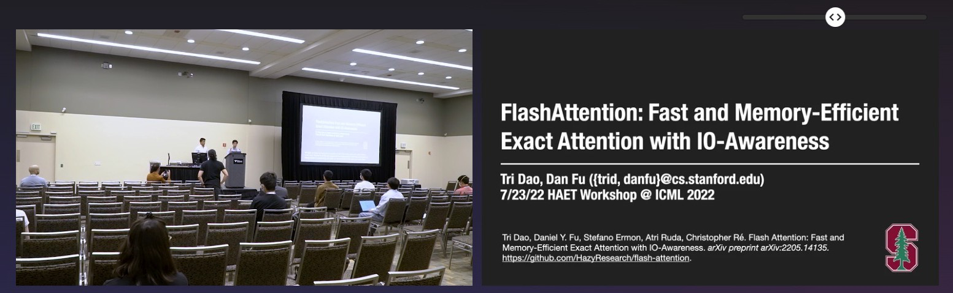
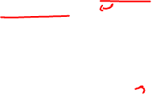
FlashAttention
One of the most impactful ideas in ML recently
Even though many people probably don’t even know they are using it!
Introduced at HAET Workshop @ ICML July 2022
Published @ NeurIPS Dec 2022
22
Figure from https://slideslive.com/38988230/flashattention-fast-and-memoryefficient-exact-attention-with-ioawareness

Slide 23
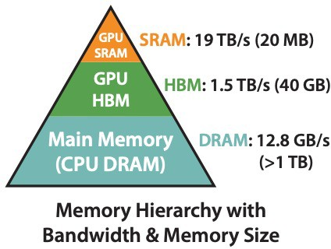
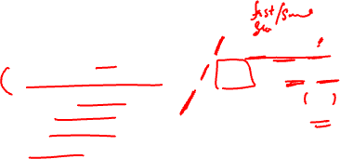
GPU Memory
Memory is arranged hierarchicaly
GPU SRAM is small, and supports the fastest access
GPU HBM is larger but with much slower access
CPU DRAM is huge, but the slowest of all
Figure from https://arxiv.org/pdf/2205.14135
24

Slide 24
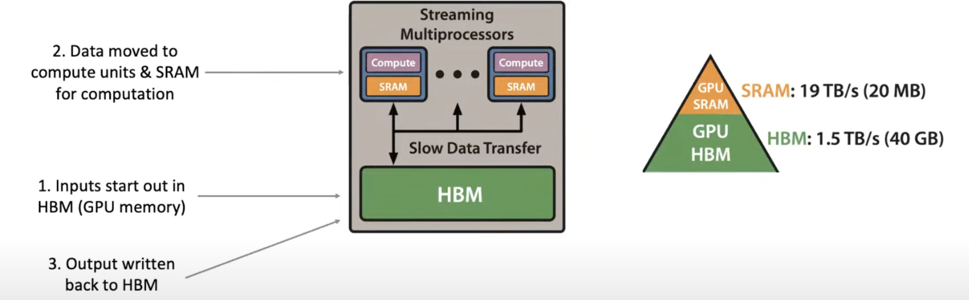
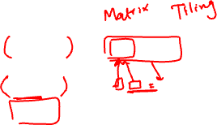
GPU Memory
24

Slide 25
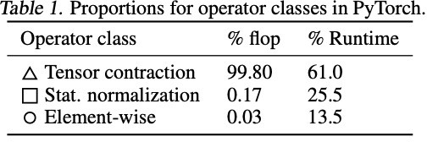
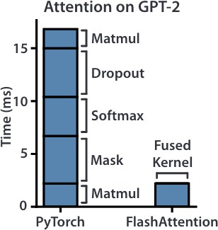
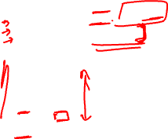
GPU Memory and Transformers
Transformer training is usually memory-bound
Matrix multiplication takes up 99% of the FLOPS
But only takes up 61% of the runtime
Lots of time is wasted moving data around on the GPU
Instead of doing computation
Figure from https://arxiv.org/pdf/2007.00072
Figure from https://arxiv.org/pdf/2205.14135
25

Slide 26
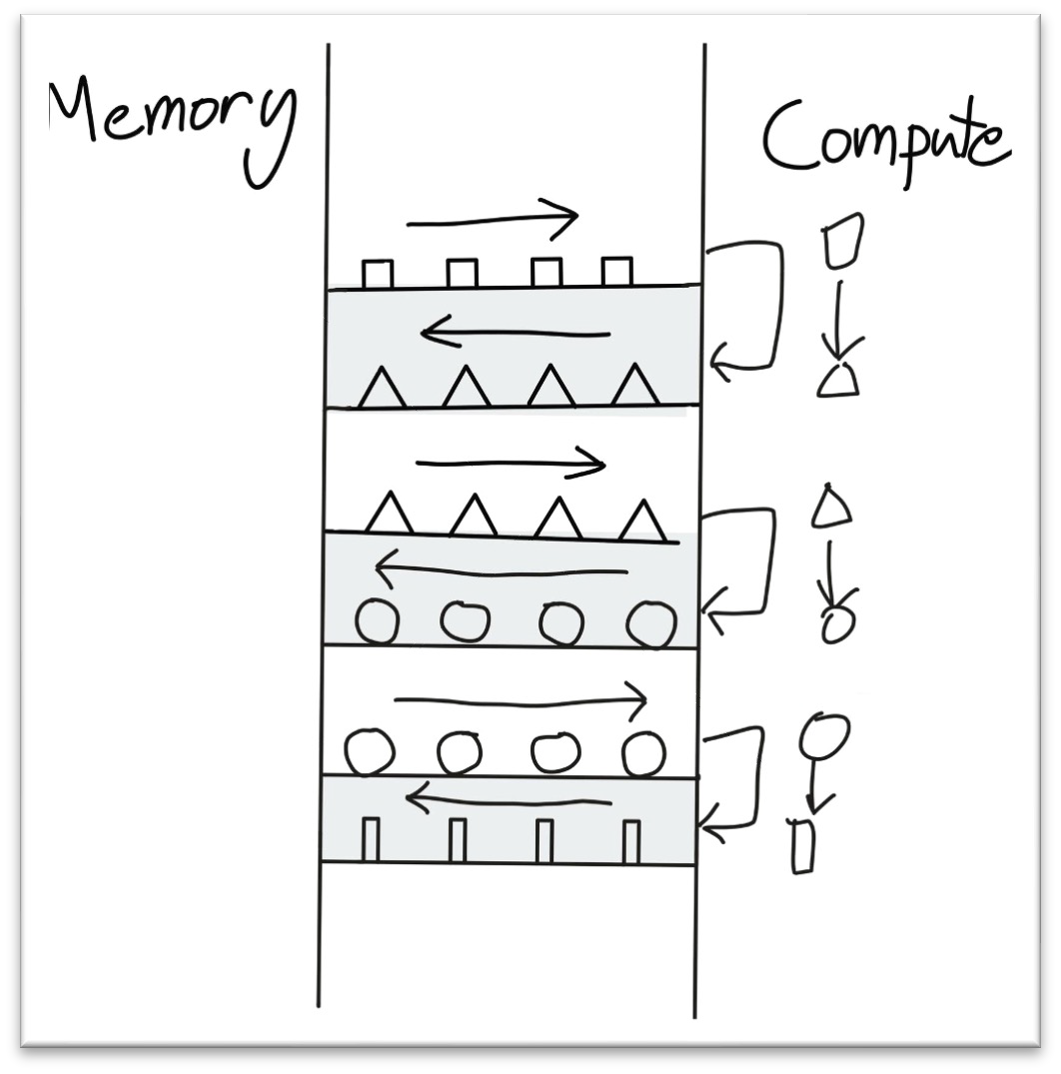
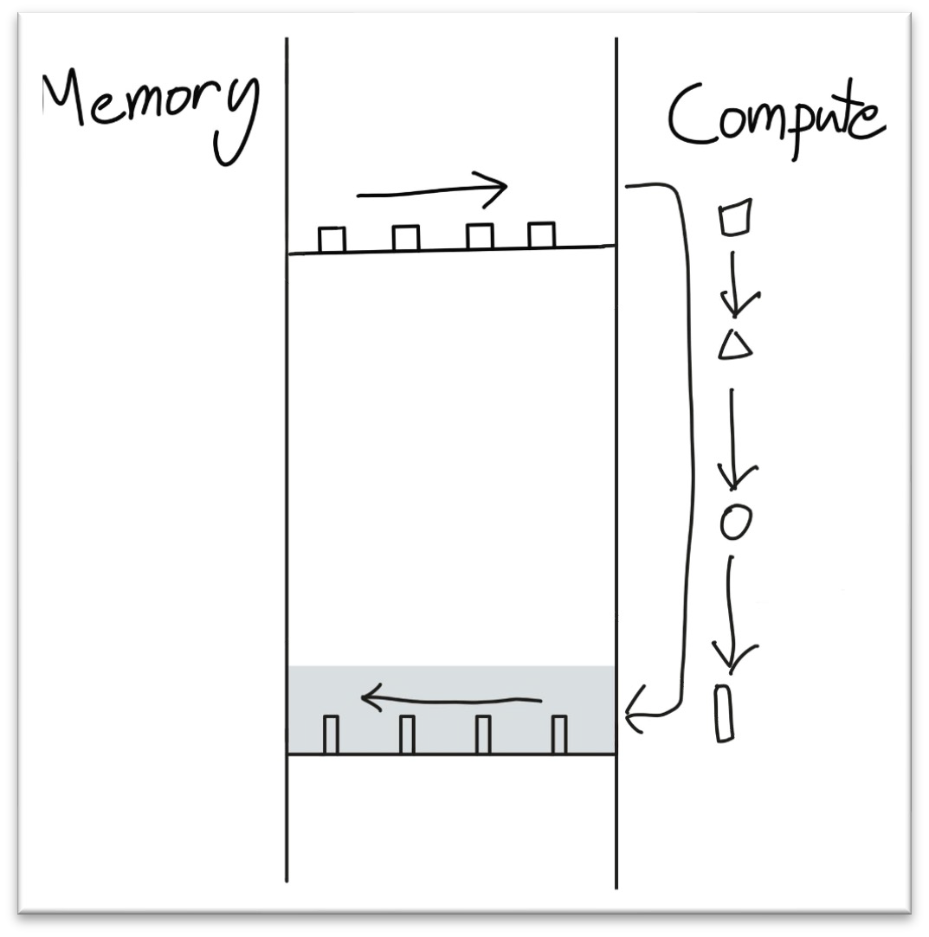
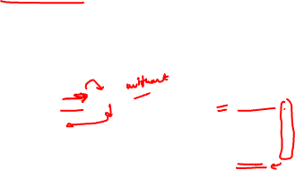
Operator Fusion
Version A: Usually, we compute a neural network one layer one at a time by moving the layer input to GPU SRAM (fast/small), doing some computation, then returning the output to GPU HBM (slow/large)
Version B: Operator fusion instead moves the original input to GPU SRAM (fast/small), does a whole sequence of layer computations without ever touching HBM, and then returns the final layer output to GPU HBM (slow/large)
Figure from https://horace.io/brrr_intro.html
26

Slide 27
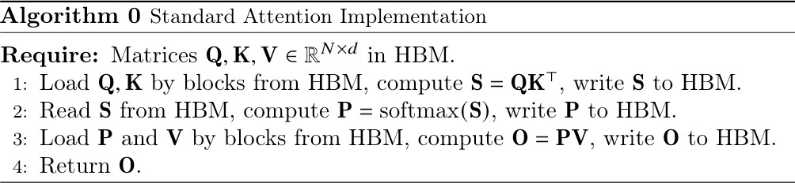
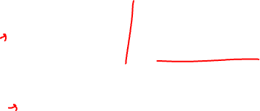
Operator Fusion
Version A: Usually, we compute a neural network one layer one at a time by moving the layer input to GPU SRAM (fast/small), doing some computation, then returning the output to GPU HBM (slow/large)
Version B: Operator fusion instead moves the original input to GPU SRAM (fast/small), does a whole sequence of layer computations without ever touching HBM, and then returns the final layer output to GPU HBM (slow/large)
Version A is exactly how standard attention is implemented
Figure from https://arxiv.org/pdf/2205.14135

Slide 28

Standard Attention
V
K Q
S
P
O
Version A is exactly how standard attention is implemented
Figure from https://arxiv.org/pdf/2205.14135

Slide 29
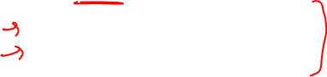
FlashAttention
Two key ideas are combined to obtain FlashAttention
Both are well-established ideas, so the interesting part is how they are put together for attention
Tiling: compute the attention weights block by block so that we don’t have to load everything into SRAM at once
Recomputation: don’t ever store the full attention matrix, but just recompute the parts of it you need during the backward pass
30

Slide 30
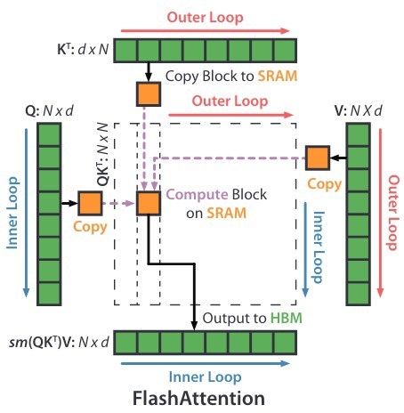
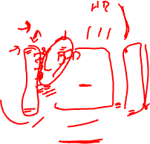
FlashAttention: Tiling
FlashAttention uses tiling to prevent materialization of the large 𝑁 × 𝑁 attention matrix (dotted box) on (relatively) slow GPU HBM. In the outer loop (red arrows), FlashAttention loops through blocks of the K and V matrices and loads them to fast on-chip SRAM. In each block, FlashAttention loops over blocks of Q matrix (blue arrows), loading them to SRAM, and writing the output of the attention computation back to HBM
Figure from https://arxiv.org/pdf/2205.14135
31

Slide 31
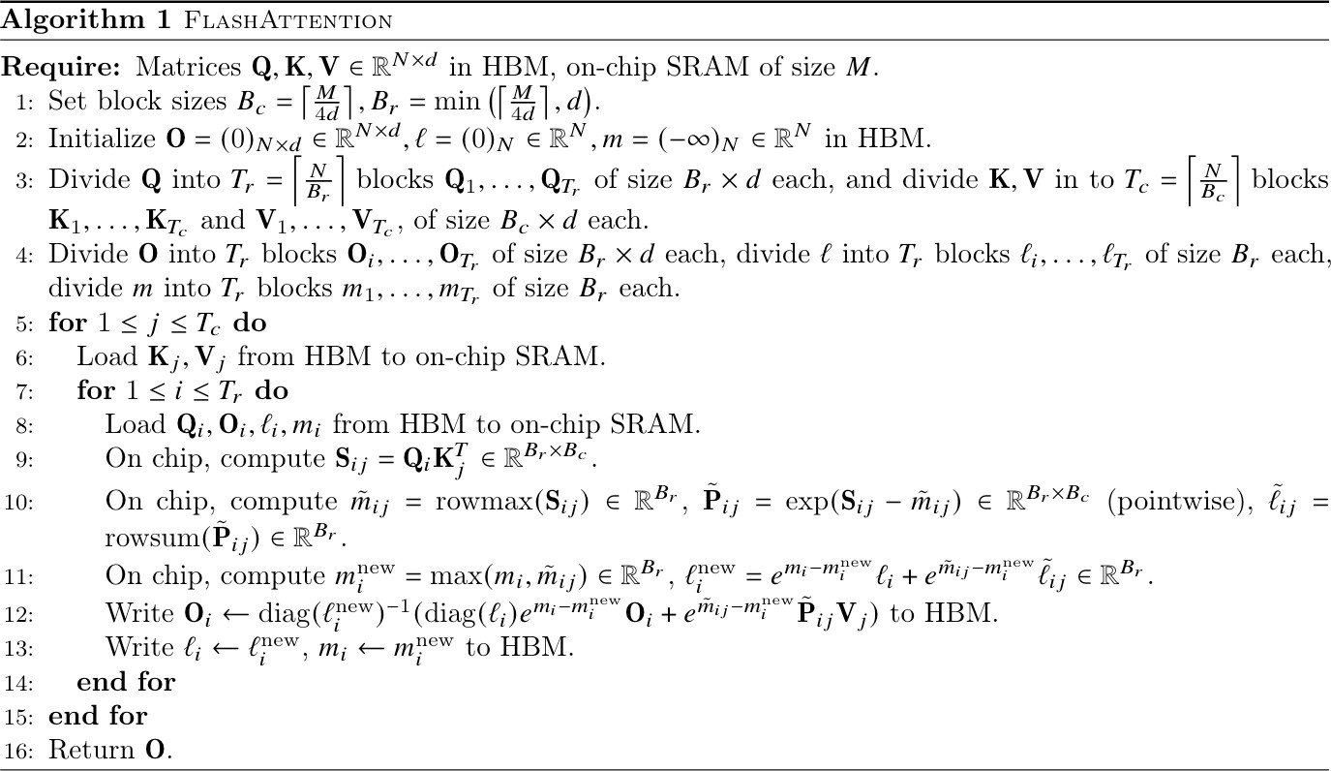
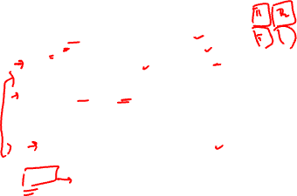
FlashAttention
33

Slide 32
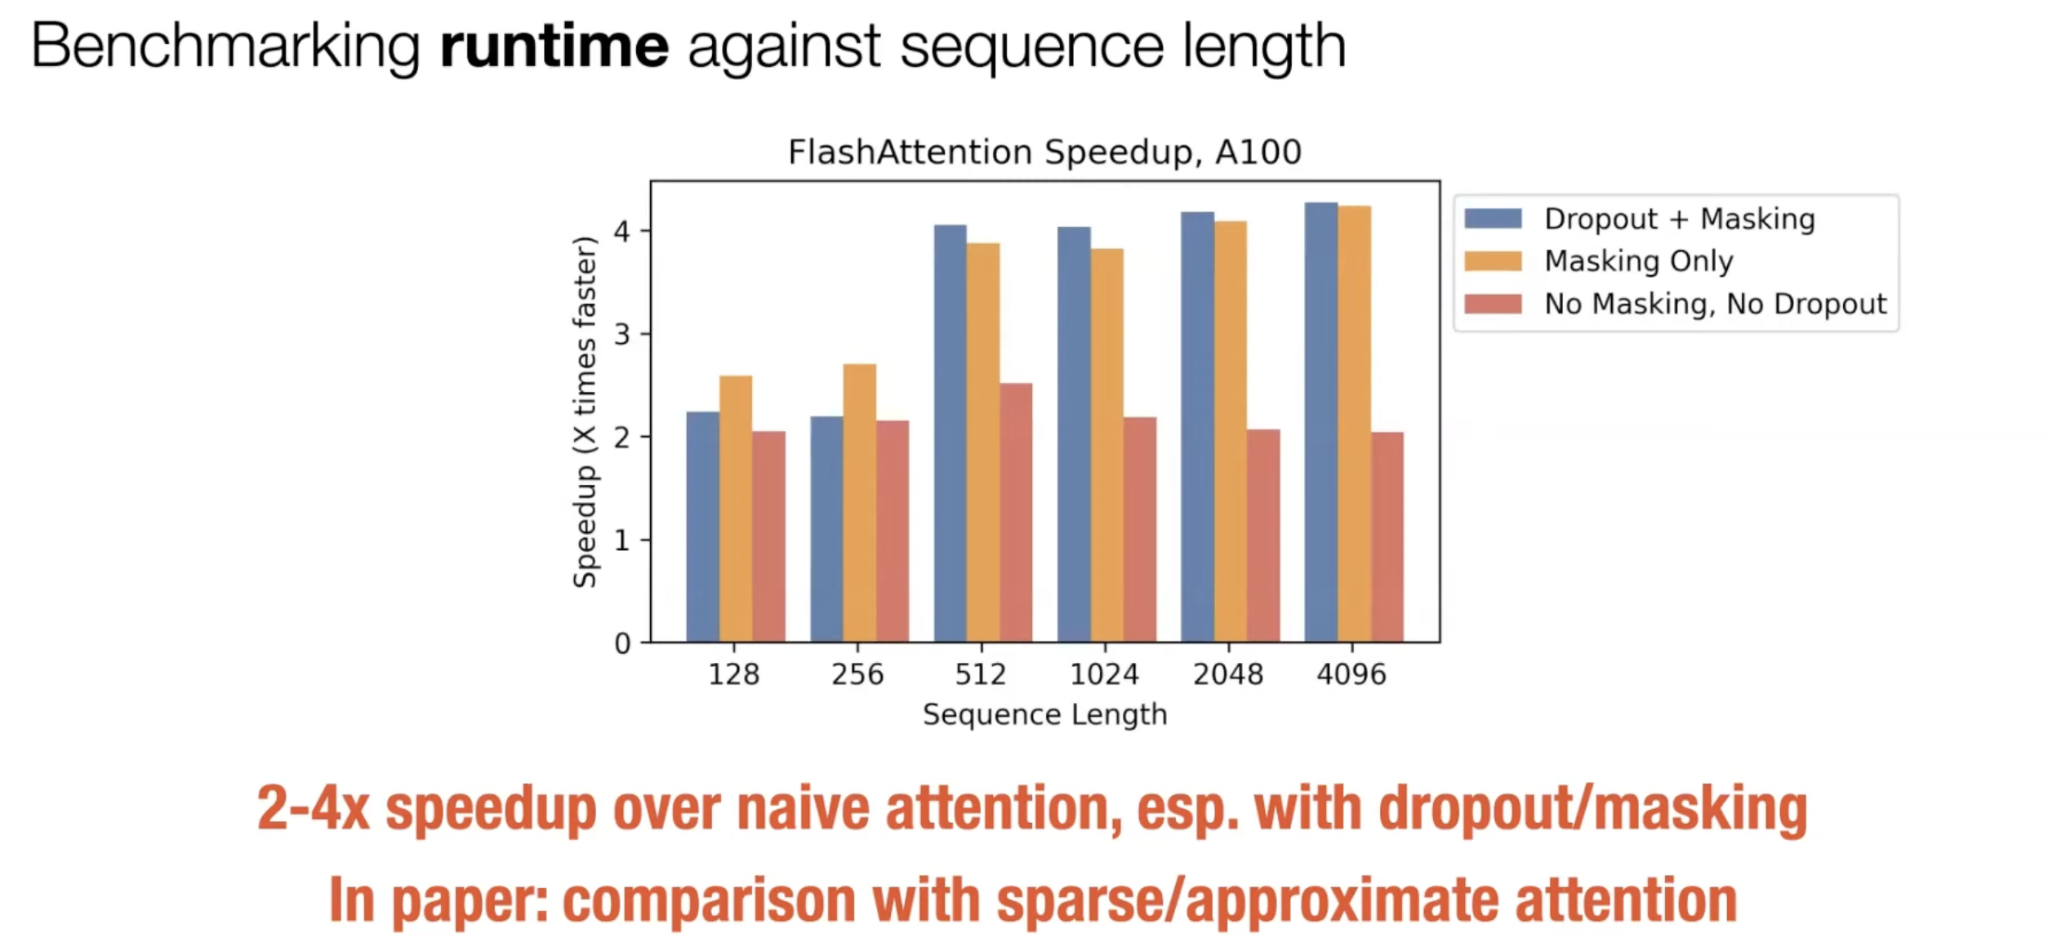
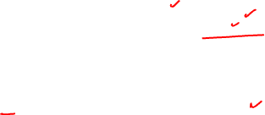
FlashAttention: Results

Slide 33
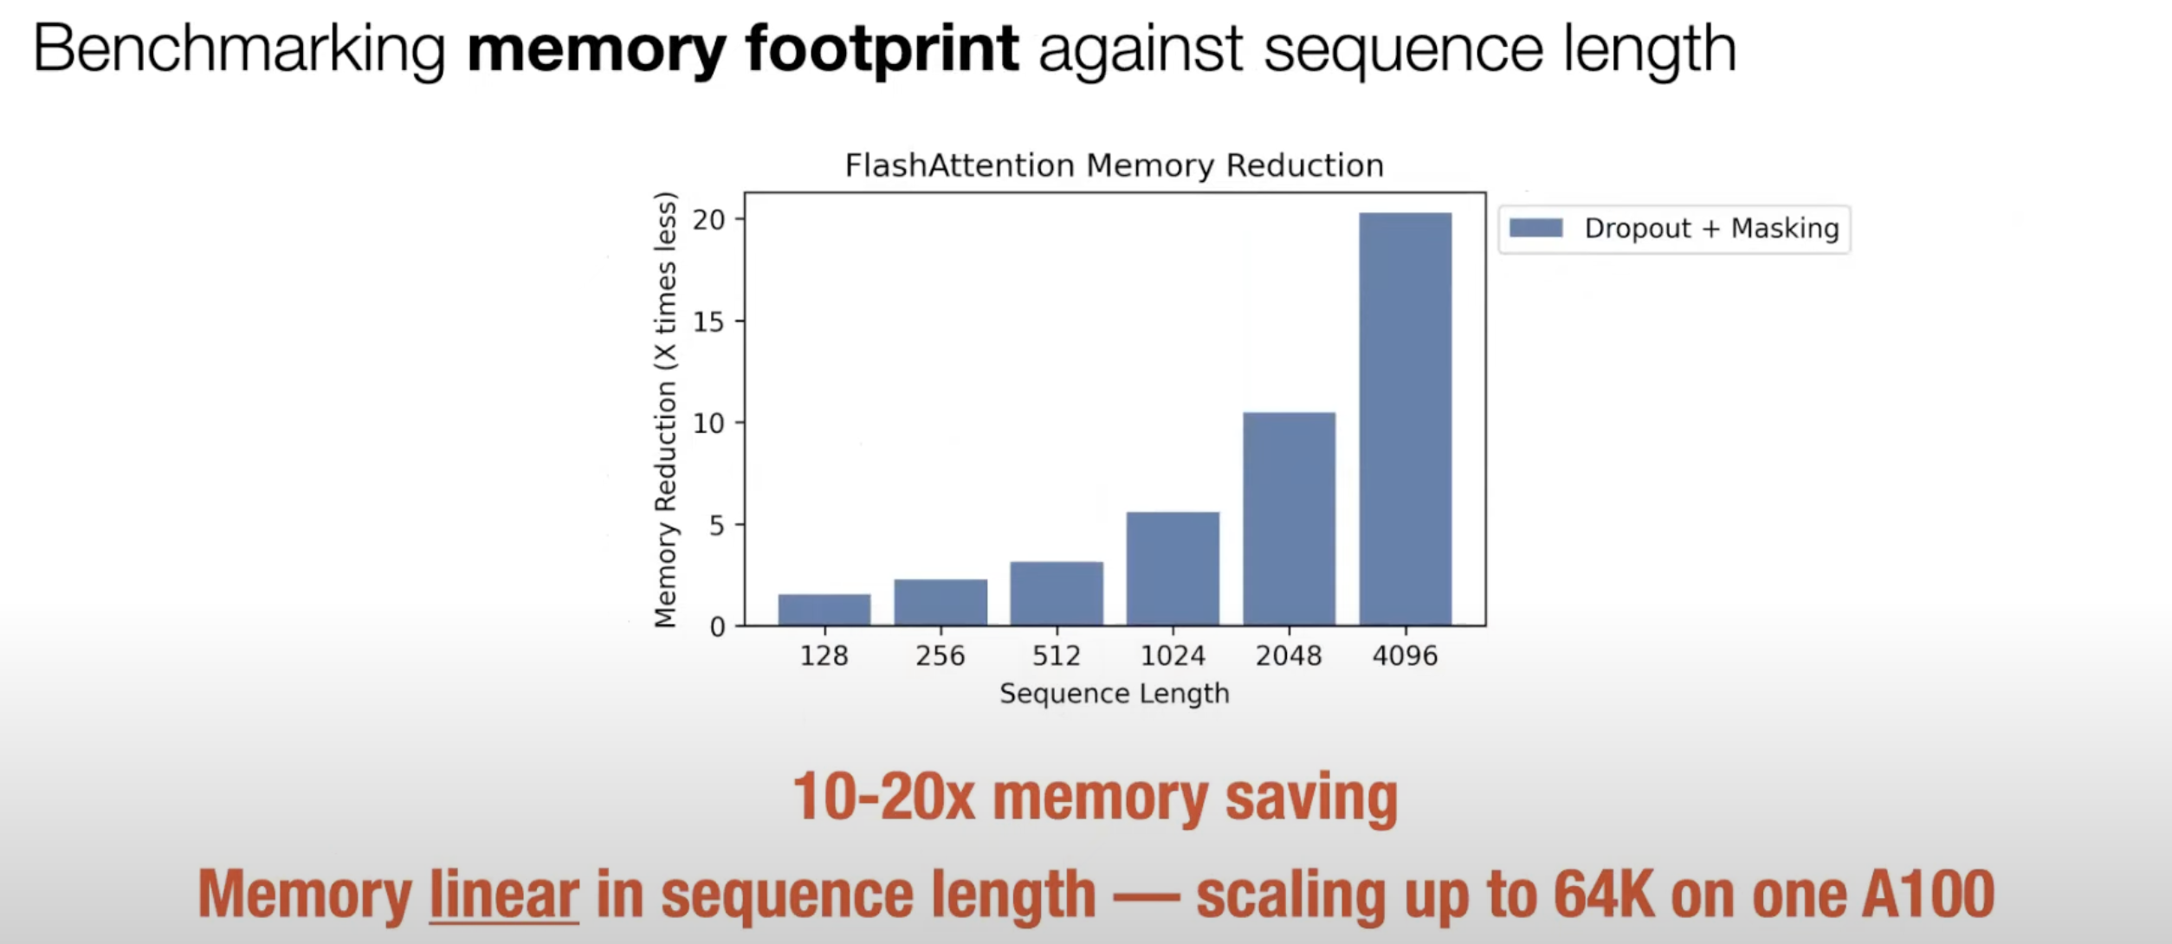
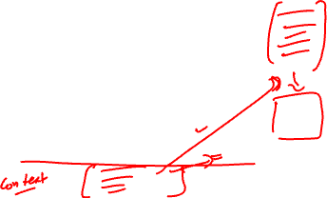
FlashAttention: Results

Slide 34
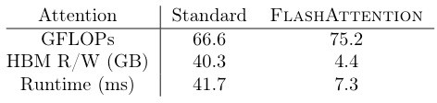


FlashAttention: Results
The algorithm is performing exact attention, so we see no reduction in perplexity or quality of the model
The key metric is runtime

Slide 35


FlashAttention: Results
The algorithm is performing exact attention, so we see no reduction in perplexity or quality of the model
The key metric is runtime

Slide 36

FlashAttention-2: Overview
▶ Paper: Dao et al. (2023)
▶ Goal: Memory-efficient and fast attention computation
▶ Highlights:
90–95% GPU utilization
2–4× faster than standard attention
▶ Techniques:
Multi-query and grouped-query attention
Hardware-aware scheduling
Supports long context windows (32k+ tokens)
▶ Adoption:
Used in OpenAI GPT-4, Mistral, LLaMA 3
Critical for scaling to trillion-parameter models efficiently
Recent Advancements in NLP

Slide 37

FlashAttention-2: Key Improvements
▶ Fewer non-matmul FLOPs:
Algorithm tweaks reduce non-matmul operations (e.g., rescaling, masking).
Maximizes use of specialized GPU units (Tensor Cores).
Non-matmul FLOPs are up to 16× more expensive than matmul FLOPs.
▶ Better Parallelism:
Parallelizes over sequence length in addition to batch size and heads.
Improves GPU utilization for long sequences and small batches.
Recent Advancements in NLP

Slide 38
FlashAttention-2: Key Improvements (cont.)
▶ Improved Work Partitioning:
Splits Q across warps (instead of K/V), reducing shared memory communication.
Yields significant speedup by minimizing synchronization.
▶ New Features:
Supports head dimensions up to 256.
Enables multi-query and grouped-query attention.
Recent Advancements in NLP

Slide 39


FlashAttention-2: Architecture (cont.)
Recent Advancements in NLP

Slide 40


FlashAttention-2: Architecture (cont.)
Recent Advancements in NLP

Slide 41

FlashAttention-2: Architecture (cont.)
▶ Multi-Query Attention: Uses a single set of keys and values for all queries, reducing memory usage.
▶ Grouped-Query Attention: Groups queries to share keys and values, further optimizing memory.
▶ Hardware-Aware Scheduling: Optimizes GPU scheduling to maximize throughput and minimize latency.
▶ Long Context Support: Efficiently handles long sequences (32k+ tokens) with minimal memory overhead.
Recent Advancements in NLP

Slide 42


FlashAttention-2: Architecture (cont.)
Iterative update of output in FlashAttention-2 with Cn = 3 iterations.
Recent Advancements in NLP

Slide 43

FlashAttention-2: Performance Benchmarks
▶ Speed:
Up to 2× faster than FlashAttention-1, 9× faster than standard PyTorch attention.
Achieves up to 335 TFLOPs/s on H100 GPUs.
▶ End-to-End Training:
1.3× speedup over optimized FlashAttention models.
Up to 225 TFLOPs/s on A100 GPU (72% model FLOPs utilization).
▶ Example Results:
Model | Baseline | FlashAttention | FlashAttention-2
GPT3-1.3B 2k | 142 | 189 | 196
GPT3-1.3B 8k | 72 | 170 | 220
GPT3-2.7B 2k | 149 | 189 | 205
GPT3-2.7B 8k | 80 | 175 | 225
▶ Baseline: Megatron-LM without FlashAttention.
Recent Advancements in NLP

Slide 44


Future Directions
Software-hardware Co-design
Recent Advancements in NLP

Slide 45


Future Directions
Long context for new interactive AI workflows
Recent Advancements in NLP

Slide 46

Mixture of Experts (MoE)
Recent Advancements in NLP

Slide 47


MoE Overview
Recent Advancements in NLP

Slide 48


MoE Overview
Recent Advancements in NLP

Slide 49

MoE Overview (cont.)
Mixture of Experts (MoE) is a neural network architecture that uses multiple ”expert” subnetworks to process inputs, allowing for efficient scaling and specialization.
▶ Experts: Each expert is a small neural network trained on specific tasks or data.
▶ Gating Mechanism: A gating network decides which experts to activate for each input, enabling dynamic routing.
▶ Scalability: MoE models can scale to billions of parameters while maintaining computational efficiency.
Recent Advancements in NLP

Slide 50
MoE: Key Idea
▶ Key Idea: Activate only a subset of the model for each input, rather than the entire network.
▶ Each input is routed to a small number of experts (typically 2 out of N), improving efficiency.
▶ A gating network determines which experts are selected for each input.
Recent Advancements in NLP

Slide 51

Notable MoE Papers
▶ Switch Transformer (Fedus et al., 2021): Efficient routing and scaling.
▶ GShard (Lepikhin et al., 2020): Large-scale MoE for multilingual translation.
▶ M6, GLaM, and recent GPT-MoE variants: Further advances in scaling and performance.
Recent Advancements in NLP

Slide 52

What is Sparsity?
▶ Sparsity: Refers to the condition where only a small fraction of the model’s parameters are active at any given time.
▶ In MoE, sparsity is achieved by activating only a few experts for each input, leading to reduced computational cost.
▶ This allows for larger models without a proportional increase in computation.
Recent Advancements in NLP

Slide 53


What is Sparsity? (cont.)
▶ Gating Network: Learns to route inputs to experts. Output is:
▶ Sparsity: If G (x )_{i} = 0, expert E_{i} is skipped, saving compute.
▶ Typical Gating: Softmax over a linear projection:
G_{σ} (x ) = Softmax(xW_{g} )
▶ Noisy Top-k Gating: Adds noise for load balancing, selects top k experts:
H(x )_{i} = (xW_{g} )_{i} + StandardNormal() · Softplus((xW_{noise} )_{i} )
G (x ) = Softmax(KeepTopK(H(x ), k))
▶ Benefits: Activating few experts speeds up training/inference and improves load balancing.
Recent Advancements in NLP

Slide 54

Load Balancing in MoEs
Problem: Without intervention, the gating network tends to route most tokens to a few experts, leading to inefficient training and poor expert utilization.
▶ Expert Overload: Popular experts receive more tokens, train faster, and become even more favored.
▶ Underutilization: Other experts receive few or no tokens, limiting their contribution.
Solution: Introduce an auxiliary loss to encourage balanced token distribution across experts.
▶ Auxiliary Loss: Penalizes uneven assignment of tokens, pushing the gating network to distribute tokens more uniformly.
▶ Expert Capacity: Each expert is assigned a maximum number of tokens it can process (capacity). Excess tokens are dropped or rerouted.
Recent Advancements in NLP
24

Slide 55


Load Balancing in MoEs (cont.)
▶ Implementation: In transformer-based MoEs, this is often controlled via an
aux loss parameter.
Auxiliary Loss Example:
where f_{i} is the fraction of tokens assigned to expert i , and n is the number of experts.
Benefits:
▶ Ensures all experts are trained and utilized.
▶ Improves model efficiency and generalization.
▶ Prevents bottlenecks and overload in popular experts.
Recent Advancements in NLP

Slide 56

MoEs and Transformers
Transformers and Scaling: Transformers demonstrate that increasing the number of parameters improves performance. Google’s GShard project explored scaling transformers beyond 600 billion parameters using MoE layers.
▶ GShard Approach: Replaces every other feed-forward (FFN) layer with an MoE layer using top-2 gating in both encoder and decoder.
▶ Distributed Training: MoE layers are shared across devices, while other layers are replicated, enabling efficient large-scale computation.
Recent Advancements in NLP

Slide 57


MoEs and Transformers (cont.)
MoE Transformer Encoder from the GShard Paper
Recent Advancements in NLP

Slide 58

MoEs and Transformers (cont.)
Load Balancing and Efficiency:
▶ Random Routing: In top-2 gating, the top expert is always selected, while the second expert is chosen probabilistically based on its gating weight.
▶ Expert Capacity: Each expert has a maximum token capacity. Overflow tokens are either sent via residual connections or dropped, ensuring static tensor shapes and balanced computation.
Why Expert Capacity?
▶ Tensor shapes must be fixed at compile time, but token distribution to experts is dynamic. Capacity factors ensure compatibility and efficiency.
Recent Advancements in NLP

Slide 59
MoEs and Transformers (cont.)
Inference Efficiency:
▶ During inference, only a subset of experts is activated per input.
▶ Shared computations (e.g., self-attention) are applied to all tokens, so the effective compute is much lower than the total parameter count.
▶ Example: A 47B parameter model with 8 experts can run with the compute of a 12B dense model; with top-2 gating, 14B parameters are used.
Recent Advancements in NLP

Slide 60

Switch Transformers
Switch Transformers: Address training and fine-tuning instabilities in MoEs by simplifying routing and improving efficiency. The authors released a 1.6T parameter MoE model with 2048 experts on Hugging Face, achieving a 4x
pre-train speed-up over T5-XXL.
▶ Switch Transformer Layer: Replaces FFN layers with MoE layers, but routes each token to a single expert (single-expert strategy), reducing router computation and communication costs while preserving quality.
▶ Expert Capacity: Defined as
tokens per batch
Expert Capacity =
( )
× capacity factor
number of experts
▶ Low capacity factors (1–1.25) are effective, balancing efficiency and communication overhead.
Recent Advancements in NLP

Slide 61
Switch Transformers (cont.)
▶ Load Balancing Loss: Simplified auxiliary loss encourages uniform routing and is weighted by a hyperparameter.
▶ Selective Precision: Experts are trained in bfloat16, while routing uses full precision to avoid instability. This reduces communication and computation costs without degrading quality.
Recent Advancements in NLP

Slide 62


Switch Transformers (cont.)
Recent Advancements in NLP

Slide 63

Switch Transformers (cont.)
Architecture:
▶ Encoder-decoder setup, similar to T5 but with MoE layers.
▶ Fine-tuning and summarization tasks are supported.
GLaM and Scaling:
▶ GLaM explores scaling MoEs further, matching GPT-3 quality with 1/3 the energy.
▶ Uses decoder-only models, top-2 routing, and larger capacity factors.
▶ Capacity factor can be adjusted during training and inference to control compute and efficiency.
Recent Advancements in NLP

Slide 64

Switch Transformers (cont.)
Recent Advancements in NLP

Slide 65
Parallelism in MoE
Parallelism Overview:
▶ Data Parallelism: Replicates model weights across all cores; data is partitioned so each core processes a different batch.
▶ Model Parallelism: Splits the model across cores; each core holds a part of the model, and data is replicated.
▶ Model and Data Parallelism: Both model and data are partitioned; different cores process different batches and hold different model segments.
▶ Expert Parallelism: Experts are distributed across workers. Each worker processes a different batch, and MoE layers route tokens to the appropriate expert on each worker.
Expert Parallelism Details:
▶ For non-MoE layers, expert parallelism acts like data parallelism.
Recent Advancements in NLP

Slide 66


Parallelism in MoE (cont.)
▶ For MoE layers, tokens are dynamically routed to the worker hosting the selected expert.
▶ Enables scaling to large numbers of experts and efficient distributed training.
Illustration of model, expert, and data parallelism (adapted from Switch Transformers)
Recent Advancements in NLP

Slide 67

Transformer vs. Mixture of Experts in LLMs
Dense Transformers:
▶ Every input token passes through all layers and all parameters.
▶ Simpler architecture and easier to implement.
▶ Scaling up increases both parameter count and computational cost proportionally.
▶ Well-suited for moderate-scale models and resource-constrained environments.
Recent Advancements in NLP

Slide 68

Transformer vs. Mixture of Experts in LLMs (cont.)
Mixture of Experts (MoE):
▶ Only a subset of experts (subnetworks) are activated for each input.
▶ Enables scaling to massive parameter counts without proportional increase in compute.
▶ Requires gating networks and load balancing mechanisms.
▶ More complex to implement and train, but highly efficient for large-scale distributed training.
Recent Advancements in NLP

Slide 69

Sparse MoEs vs Dense Models
When to Use Sparse MoEs:
▶ Ideal for high-throughput scenarios with access to many machines.
▶ Given a fixed compute budget for pretraining, sparse MoEs are more optimal due to efficient parameter utilization.
▶ Enables scaling to very large models without a proportional increase in computation.
When to Use Dense Models:
▶ Preferable for low-throughput scenarios or when limited VRAM is available.
▶ Simpler to implement and deploy on single devices.
▶ More suitable for smaller-scale tasks or resource-constrained environments.
Note: The number of parameters in sparse and dense models cannot be directly compared, as they represent fundamentally different architectures and computational trade-offs.
Recent Advancements in NLP

Slide 70


Transformer vs. Mixture of Experts in LLMs (cont.)
Recent Advancements in NLP

Slide 71

Transformer vs. Mixture of Experts in LLMs (cont.)
Comparison:
▶ Efficiency: MoEs are more compute-efficient for large models, as only a fraction of parameters are used per token.
▶ Scalability: MoEs allow scaling to trillions of parameters, while dense transformers are limited by hardware constraints.
▶ Specialization: MoEs can specialize experts for different data or tasks, potentially improving performance.
▶ Complexity: Dense transformers are easier to deploy and maintain; MoEs require careful engineering for routing and load balancing.
Recent Advancements in NLP

Slide 72

Transformer vs. Mixture of Experts in LLMs (cont.)
Use Cases:
▶ Dense transformers: Small to medium LLMs, single-device inference, low-latency applications.
▶ MoEs: Large-scale pretraining, multi-device distributed systems, scenarios where efficiency and specialization are critical.
Recent Advancements in NLP

Slide 73
MoE: Advantages
▶ Scales efficiently to very large models.
▶ Reduces computation cost per token by activating only a few experts.
▶ Well-suited for distributed training across multiple devices.
▶ Enables specialization among experts, potentially improving performance.
Recent Advancements in NLP

Slide 74

MoE: Challenges
▶ Complex routing and expert selection mechanisms.
▶ Load balancing: Ensuring all experts are utilized effectively.
▶ Training instability and convergence issues.
▶ Increased implementation complexity compared to standard models.
Recent Advancements in NLP

Slide 75


Sparse Models for Computer Vision
Recent Advancements in NLP

Slide 76


Sparse Models for Computer Vision
Recent Advancements in NLP

Slide 77

The LLaMA 3 Herd of Models
Recent Advancements in NLP

Slide 78


The LLaMA 3 Herd of Models
Recent Advancements in NLP

Slide 79

The LLaMA 3 Herd of Models
Recent Advancements in NLP

Slide 80

The LLaMA 3 Herd of Models (cont.)
Meta AI (2024)
▶ Model Sizes: 8B, 70B, and smaller variants
▶ Open Weights: Available for commercial use
▶ Training: Over 15 trillion tokens, multilingual data, improved alignment techniques
Recent Advancements in NLP

Slide 81

The LLaMA 3 Herd of Models (cont.)
Recent Advancements in NLP

Slide 82

The LLaMA 3 Herd of Models (cont.)
Key Features:
▶ 128k context window for extended input sequences
▶ FlashAttention-2 and grouped-query attention for efficient inference
▶ Fine-tuned variants: Instruct and Chat models
Recent Advancements in NLP

Slide 83


The LLaMA 3 Herd of Models (cont.)
Recent Advancements in NLP

Slide 84


The LLaMA 3 Herd of Models (cont.)
Recent Advancements in NLP

Slide 85

The LLaMA 3 Herd of Models (cont.)
Recent Advancements in NLP

Slide 86

The LLaMA 3 Herd of Models (cont.)
Recent Advancements in NLP

Slide 87

The LLaMA 3 Herd of Models (cont.)
Highlights:
▶ Competitive performance with GPT-4 and Gemini
▶ Foundation for Code LLaMA, Audio LLaMA, and multimodal LLaMA models
Recent Advancements in NLP

Slide 88

DeepSeek & GRPO
Recent Advancements in NLP

Slide 89


Supervised Fine-tuning (SFT) in LLMs
Augments input-output examples with instructions, which enables instruction-tuned models to generalize more easily to new tasks.

Slide 90
Supervised Fine-tuning (SFT) in LLMs
Augments input-output examples with instructions, which enables instruction-tuned models to generalize more easily to new tasks.
Instruction: Translate the following English text to French.
Input-output: The weather is nice today. → Le temps est agréable aujourd'hui.
Instruction: Determine the sentiment of the following review.
Input-output: I love this product! It works perfectly. → Positive

Slide 91

DeepSeek-R1 models
DeepSeek-R1-Zero, a model trained via large-scale reinforcement learning (RL) without supervised fine-tuning (SFT) as a preliminary step.
However, it encounters challenges such as poor readability, and language mixing.
DeepSeek-R1addresses these challenges by incorporating a multi-stage training and cold-start data before RL.

Slide 92


DeepSeek Training Paradigm
https://x.com/SirrahChan/status/1881488738473357753/photo/1
https://www.youtube.com/watch?v=QdEuh2UVbu0&list=WL&index=10

Slide 93



Revisiting Reinforcement Learning (RL)
State is a round of stick throwing.
Action: the dog moving toward the stick.
Reward: a treat.
Policy defines how an agent behave at a certain state. How to assign the reward.
The objective is to find the policy that maximizes the reward.

Slide 94


Analogy to LLMs
Agent: the LLM itself.
State: the initial input.
Action: next token prediction.
Policy: defines the behavior of the LLM. In other words, define the word distribution.
Reward: a numerical value to identify the correctness of the chosen action.

Slide 95


Group Relative Policy Optimization (GRPO)
GRPO algorithm is based on the Proximal Policy Optimization (PPO) algorithm¹².
Reward model is a trained model that assigns rewards.
Value model estimates the long-term expected future reward from a given state.
¹ Schulman et al 2017: Proximal Policy Optimization Algorithms
² Shao et al., 2024: DeepSeekMath

Slide 96
Group Relative Policy Optimization (GRPO)
GRPO generates multiple responses at once and generates multiple rewards.
Group computation decides the advantage of the response based on other responses in the group.
The value model is removed since it’s expensive to evaluate multiple actions every state.

Slide 97



Group Relative Policy Optimization (GRPO)
Optimizes the policy to maximize the objective J_{GRPO}.
For every question (q), the model generates multiple outputs (o_{i}).
Scale the reward by the ratio or clipped ratio (conservative updates).
Maintain divergence from the ref model (base model).

Slide 98

Reward Modeling in GRPO
Uses a rule-based reward system with two types:
Accuracy rewards: Ensures correct responses (e.g., math, LeetCode).
Format rewards: Employ a format reward model that enforces the model to put its thinking process between ‘<think>’ and ‘</think>’ tags.

Slide 99

DeepSeek-R1-Zero Response Length

Slide 100

DeepSeek-R1-Zero outperforms O1-mini in math and coding benchmarks

Slide 101


Aha Moment of DeepSeek-R1-Zero

Slide 102
Drawback of DeepSeek-R1-Zero
DeepSeek-R1-Zero struggles with challenges like
poor readability, and
language mixing.
“To make reasoning processes more readable, we explore DeepSeek-R1, a method that utilizes RL with human-friendly cold-start data.”

Slide 103
DeepSeek-R1
Start again from the V3 Base model.
Perform supervised fine-tuning (SFT) for 2 epochs.
Perform Reinforcement Learning (RL) to improve helpfulness and harmlessness.

Slide 104
DeepSeek-R1 SFT data

Slide 105

DeepSeek-R1 Distillation

Slide 106

DeepSeek-R1 achieves OpenAI O1 in math and coding benchmarks

Slide 107

DeepSeek-R1 achieves SOTA* LLMs in different benchmarks

Slide 108

Distilled Model Evaluation

Slide 109

Takeaways
DeepSeek-R1 matches OpenAI o1 in complex reasoning tasks.
DeepSeek-R1-zero achieves strong logical reasoning without supervised fine-tuning.
Distillation enables smaller models to inherit advanced reasoning capabilities from DeepSeek-R1.

Slide 110

Byte Latent Transformer (BLT)
Recent Advancements in NLP

Slide 111

Byte Latent Transformer (BLT)
Recent Advancements in NLP

Slide 112

Byte Latent Transformer (BLT) (cont.)
BLT is a compression-based approach for efficient LLMs:
▶ Compress input text into a smaller latent space
▶ Run transformer on latent tokens
▶ Decode with a decoder-only model
Reduces memory & compute
Maintains quality (BLEU, perplexity)
Works well with long context (128k+)
Related: VQ-VAE, tokenizer-free models, compression transformers Meta AI (2024) https://ai.meta.com/research/publications/
byte-latent-transformers-compression-based-efficiency-for-byte-level-llms/
Recent Advancements in NLP

Slide 113


Byte Latent Transformer (BLT) (cont.)
Recent Advancements in NLP

Slide 114


Byte Latent Transformer (BLT) (cont.)
Recent Advancements in NLP

Slide 115


Byte Latent Transformer (BLT) (cont.)
Recent Advancements in NLP

Slide 116


Encoder Multi-Headed Cross-Attention (cont.)
Recent Advancements in NLP

Slide 117

BLT Performance
BLT Performance:
▶ BLT achieves state-of-the-art performance on long-context benchmarks.
▶ Outperforms existing LLMs in terms of perplexity and BLEU scores.
▶ Efficiently handles long sequences (128k+ tokens) with reduced memory and compute requirements.
Recent Advancements in NLP

Slide 118

BLT Performance
Recent Advancements in NLP

Slide 119

BLT Performance (cont.)
Recent Advancements in NLP

Slide 120

BLT Performance (cont.)
Recent Advancements in NLP

Slide 121

Large Language Diffusion Models (LLDMs)
Recent Advancements in NLP

Slide 122

LLDMs: Diffusion for Text Generation
Recent Advancements in NLP

Slide 123

LLDMs: Diffusion for Text Generation (cont.)
▶ Emerging trend: Use diffusion instead of autoregression for text generation
Key Idea:
▶ Generate latent text representation over diffusion steps
▶ Use decoder to map latent → text
Benefits:
▶ Better global coherence
▶ Parallel generation
▶ Less repetition, hallucination
Recent Advancements in NLP

Slide 124
LLDMs: Diffusion for Text Generation (cont.)
Related work:
▶ Diffusion-LM (Li et al.)
▶ Masked-Diffusion Transformers
▶ UniDiffuser (Vision + Text)
Note: Still experimental, but promising for the future of text generation
Recent Advancements in NLP

Slide 125


LLDMs: Diffusion for Text Generation (cont.)
Recent Advancements in NLP

Slide 126


LLDMs: Diffusion for Text Generation (cont.)
Recent Advancements in NLP

Slide 127

LLDMs: Diffusion for Text Generation (cont.)
Recent Advancements in NLP

Slide 128

LLDMs: Diffusion for Text Generation (cont.)
Recent Advancements in NLP

Slide 129

LLDMs: Algorithm Overview
Recent Advancements in NLP

Slide 130

LLDMs: Algorithm Overview (cont.)
Recent Advancements in NLP

Slide 131

LLDMs: Algorithm Overview (cont.)
Recent Advancements in NLP

Slide 132
Segment Everything Everywhere All at Once (SEEM)
Recent Advancements in NLP

Slide 133

Segment Everything Everywhere All at Once (SEEM)
Recent Advancements in NLP

Slide 134
Segment Everything Everywhere All at Once (SEEM)
SEEM is a promptable panoptic segmentation model designed to segment any region, object, or stuff in an image using various input modalities such as text, points, boxes, or masks.
▶ Unified Segmentation: Supports instance, semantic, and panoptic segmentation.
▶ Versatility: Works with any image, any resolution, and enables zero-shot segmentation.
▶ Multimodal Prompts: Accepts prompts in multiple forms, including text, points, boxes, and masks.
▶ Video and Open Vocabulary: Capable of segmenting video frames and handling open vocabulary tasks.
▶ Foundation for Interactive Systems: Serves as a foundation for real-time, interactive vision systems.
Recent Advancements in NLP

Slide 135

Segment Everything Everywhere All at Once (SEEM)
Recent Advancements in NLP

Slide 136

Segment Everything Everywhere All at Once (SEEM)
Recent Advancements in NLP

Slide 137

Segment Everything Everywhere All at Once (SEEM)
Recent Advancements in NLP

Slide 138

SEEM - Results
Recent Advancements in NLP

Slide 139

SEEM - Results (cont.)
Recent Advancements in NLP

Slide 140

SEEM - Results (cont.)
Recent Advancements in NLP

Slide 141

SEEM - Results (cont.)
Recent Advancements in NLP

Slide 142
Summary
Recent Advancements in NLP

Slide 143
Comparative Overview
Advancement | Domain | Key Benefit
SEEM | Vision | Promptable segmentation
MoE | LLM/NLP | Sparse, scalable training
FlashAttention-2 | LLM Efficiency | Fast long-context inference
LLaMA 3 | NLP | Open GPT-4 level models
DeepSeek + GRPO | NLP | Safe, aligned LLM training
BLT | NLP/LLM | Token compression efficiency
LLDMs | NLP | Diffusion-based generation
Recent Advancements in NLP

Slide 144
Future Directions
▶ Multimodal Foundation Models
▶ Efficient Training (QLoRA, MoE, FlashAttention)
▶ LLMs with Memory, Tools, Agents
▶ Transformer Alternatives (MLPs, State Space Models)
▶ Unified Models: Language, Vision, Audio, Action
Integration of these advances will define AI agents, robotics, and autonomous systems.
Recent Advancements in NLP

Slide 145
Key Takeaways
▶ SEEM: Revolutionizes image segmentation with prompt-based control.
▶ MoE: Enables sparse expert usage for massive model scaling.
▶ FlashAttention-2: Accelerates transformer inference and improves memory efficiency.
▶ LLaMA 3 & DeepSeek: Provide top-tier open-source LLMs.
▶ GRPO: Advances LLM alignment beyond PPO.
▶ BLT: Reduces input redundancy for efficient token compression.
▶ LLDMs: Introduce diffusion-based generation as a radical shift.
Recent Advancements in NLP

Slide 146
References
Recent Advancements in NLP

Slide 147
References
▶ SEEM: https://segment-anything.com/seem
▶ FlashAttention-2: Dao et al., 2023 (arXiv:2307.08691)
▶ LoRA: Hu et al., 2021
▶ Mixture of Experts: Fedus et al., 2021 (Switch Transformer), Lepikhin et al., 2020 (GShard)
▶ LLaMA 3: Meta AI 2024 release notes
▶ DeepSeek + GRPO: https://github.com/deepseek-ai
▶ BLT: Meta AI, 2024 (arXiv:2404.11450)
▶ LLDM: Li et al., 2022 (Diffusion-LM), MaskGIT, UniDiffuser
▶ GRPO: Sun et al., 2024
Recent Advancements in NLP

Slide 148
References (cont.)
Resources:
▶ HuggingFace ModelHub & Papers
▶ Meta AI blog
▶ DeepSeek official GitHub
▶ Open LLM Leaderboard: https://huggingface.co/spaces/HuggingFaceH4/open-llm-leaderboard
Recent Advancements in NLP

Slide 149
Credits
Dr. Prashant Aparajeya
Computer Vision Scientist — Director(AISimply Ltd)
p.aparajeya@aisimply.uk
This project benefited from external collaboration, and we acknowledge their contribution with gratitude.

